Slide 1
K J Somaiya College of Engineering, Mumbai-77
(Constituent college of Somaiya Vidyavihar University)
Title : Automatic Question Classifier
Group ID: C12
Thrust Area: Machine Learning & NLP
Guides: Prof Mansi Kambli & Prof Khushi Khanchandani
Group Members:
Ojas Kulkarni - 1811064
Aniket Joshi- 1811083
Vineeta Bhujle - 1814066
Neha Patil - 1814098

Slide 2
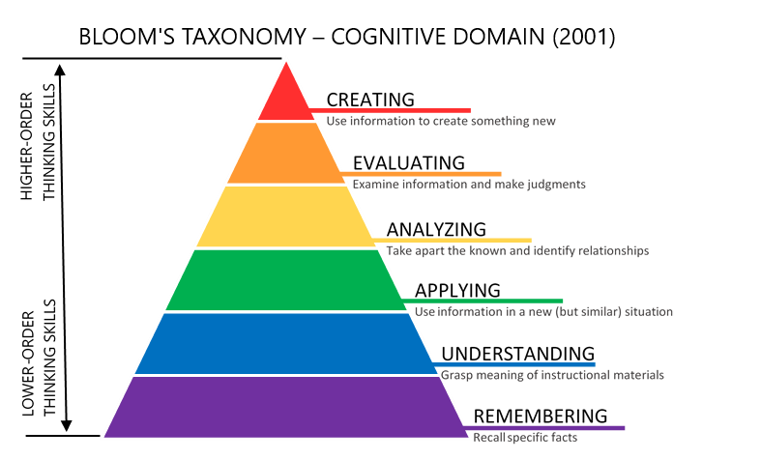
Problem Definition
Facilitating the creation of balanced question papers to evaluate students on different levels based on Bloom’s Taxonomy.
Notes:
As mentioned in the last semester, the problem statement we chose was based on Blooms Taxonomy for classification of questions. We focused on facilitating the creation of balanced question papers to evaluate students based on Blooms taxonomy and hence have built an Automatic question classifier

Slide 3
Problem Definition
Existing method of implementation: Simple mapping of verbs -> levels
Limitations:
action verbs are not always the indicator of level.
some verbs are associated with multiple levels.
Proposed solution:
ML Classifier will solve the above issues and automates the categorisation process
Notes:
AICTE examination reforms:
Quite often, the action verbs are indicators of the complexity (level) of the question. BUT NOT ALWAYS
some of the verbs in the above table are associated with multiple Bloom’s Taxonomy levels. These verbs are actions that could apply to different activities. CONFUSION for categorisation
Eg: describe could be remembering or understanding.

Slide 4
Scope
Users can register and login to the application using a Google account.
Users can manually create a question bank and enter questions by typing.
The ML classifier will classify the question based on Bloom’s Taxonomy.
User can view the analytics dashboard of a question bank.
User can generate a balanced paper from the question bank.
User can share the paper as a Google Form or PDF.
User can view previously generated papers.
Notes:
Moving on to the scope of our project,

Slide 5
Scope
Removed from scope:
OCR
Handwriting recognition
Outside the scope:
Not a testing environment.
No designation of marks to questions.
No evaluation of responses received by students.
Subquestions not allowed.
Notes:
Not a testing environment for the students to take the tests created by the faculties as google forms.
The new question paper generated does not take into account the marks designated for each question, it generates the question paper based on the number of questions given as input by the user.
The platform will not evaluate the tests created by the faculties or do any sort of analytics on the responses received from the google forms.

Slide 6
Functional Requirements
Login with Google account
Create,read, update and delete question banks, questions.
Dashboard to show results predicted by the model along with other insights.
Get an insight from the system if distribution of questions is not in accordance with the defined standard.
Generate a new paper from a question bank for testing purposes.
View previously created question papers.
Create and export question paper to a Google form or PDF automatically.
Notes:
The functional requirements are as follows-

Slide 7
Non-Functional Requirements
Reliability
Maintainability
Usability
Availability
Notes:
Reliability : The system shall be reliable in the terms of no data leakage and secured connection.
Maintainability : The system shall be easily maintainable. All of the user's data will be backed up weekly and stored in our database.
Usability : The system shall be easy to use by anyone. The interface will be user friendly with evident functional buttons and constant background colour throughout.
Availability : The system shall be available at all times and all places with an internet connection. The application will be available on all the latest versions of web browsers.

Slide 8
Hardware Requirements
Operating System: Windows, Linux, Mac OS
Processor: Pentium or later
RAM: 1 GB or more

Slide 9
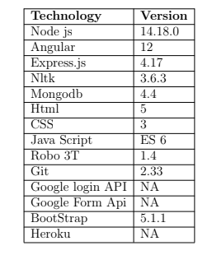
Software Requirements
Notes:
Vineeta will take over from the next slide

Slide 10
Literature Survey
Citation | Contents
[2] | Demonstrates the utilization of Bloom’s Taxonomy in examinations and claims that a system that automates the analysis of tests based on Bloom’s taxonomy can support the teacher in analysing the quality of test items and reduce the workload of teachers.
AICTE | States that creating, evaluating and analysing should be conducted as projects or internship experience. They have recommended no more than 40% weightage for knowledge-oriented questions in examinations.
Notes:
[2] curriculum planning, teaching target and teaching assessment,
Aicte- the first three levels of taxonomy that is creating, evaluating and analysing should be conducted as course projects, mini project, minor project or internship experience throughout the semester period. Applying, understanding and remembering can be accessed through timed end semester examinations.

Slide 11
Literature Survey
Paper Name | Abstract | Classifier used
[5] | A system to classify the learning content available in web sites into three levels: beginner, intermediate and advanced. | Random forest classifier
[6] | Implemented an application to help the teachers to build a test, analysis of the question paper based on Bloom’s Taxonomy and conduct an online test. The students can also login to the portal and analyse their results. | No Classifier, Keyword extraction.
Notes:
[5]They have found out that adding blooms taxonomy verbs to the feature set has increased the accuracy.
[6] Each question is broken down into keywords and each keyword is associated with a weight and a level.

Slide 12
Literature Survey
Citation | Contents
[7] | Deduces that the main pre-processing tasks in NLP are: tokenization,lemmatization, part-of-speech tagging and parsing.
[17] | Explained the use of WordNet similarity algorithm to identify the category of questions according to Bloom’s Taxonomy.
Notes:
WordNet similarity is used to measure the semantic similarity between the keywords from the questions and the Bloom’s Taxonomy keywords.

Slide 13
Papers | [11] | [12] | [13] | [9] | [15] | [16] | Our Algorithm
Feature extraction | NA | Chi-Square+Laplace Smoothing | Chi-Square,Mutual Information, and Odd Ratio | TFPOS-IDF and word2vec | NA | Pos Tagging and Word Vector | TFPOS-IDF
Classifiers | SVM, K-NN. | Naive Bayes | Naïve Bayes(NB), (KNN). | KNN, Logistic Regression, SVM | SVM-Light | Rule based grammar, , Ensemble Technique on KNN, SVC and NB, Wordnet. | Ensemble Technique on KNN, SVC and NB.
Accuracy | SVM: 69% K-NN: 65% | 60.63%. | KNN: 87%. NB: 83%. | KNN: 71.1%, LR: 82.3% SVM: 83.7% | 87.4%. Poor recall and F-measure values | Ensemble: 82.5% Rule Based: 60% | 93.5% Precision: 94% Recall: 93%
Notes:
verbs are the most important words to determine the level of the question according to Bloom’s taxonomy last is pronoun pronoun -[9]

Slide 14
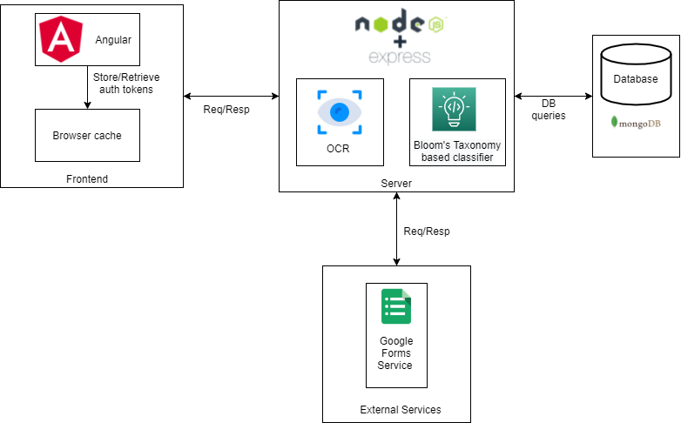
Proposed System - Web Application
Notes:
User can create decks add question to those decks get insights to the deck using dashboard. He can generate a paper and convert it to a google form or download it as a pdf file.
Web application- MEAN technology stack.
Frontend / Presentation Layer: Angular and Bootstrap
Backend / Server / Business Logic Layer: Node.js , Express.js
Data Layer: MongoDB
Communication- REST API
External Services used- Google OAuth, Google Forms Services.
Classification model- Flask
Hosting the model- Heroku

Slide 15
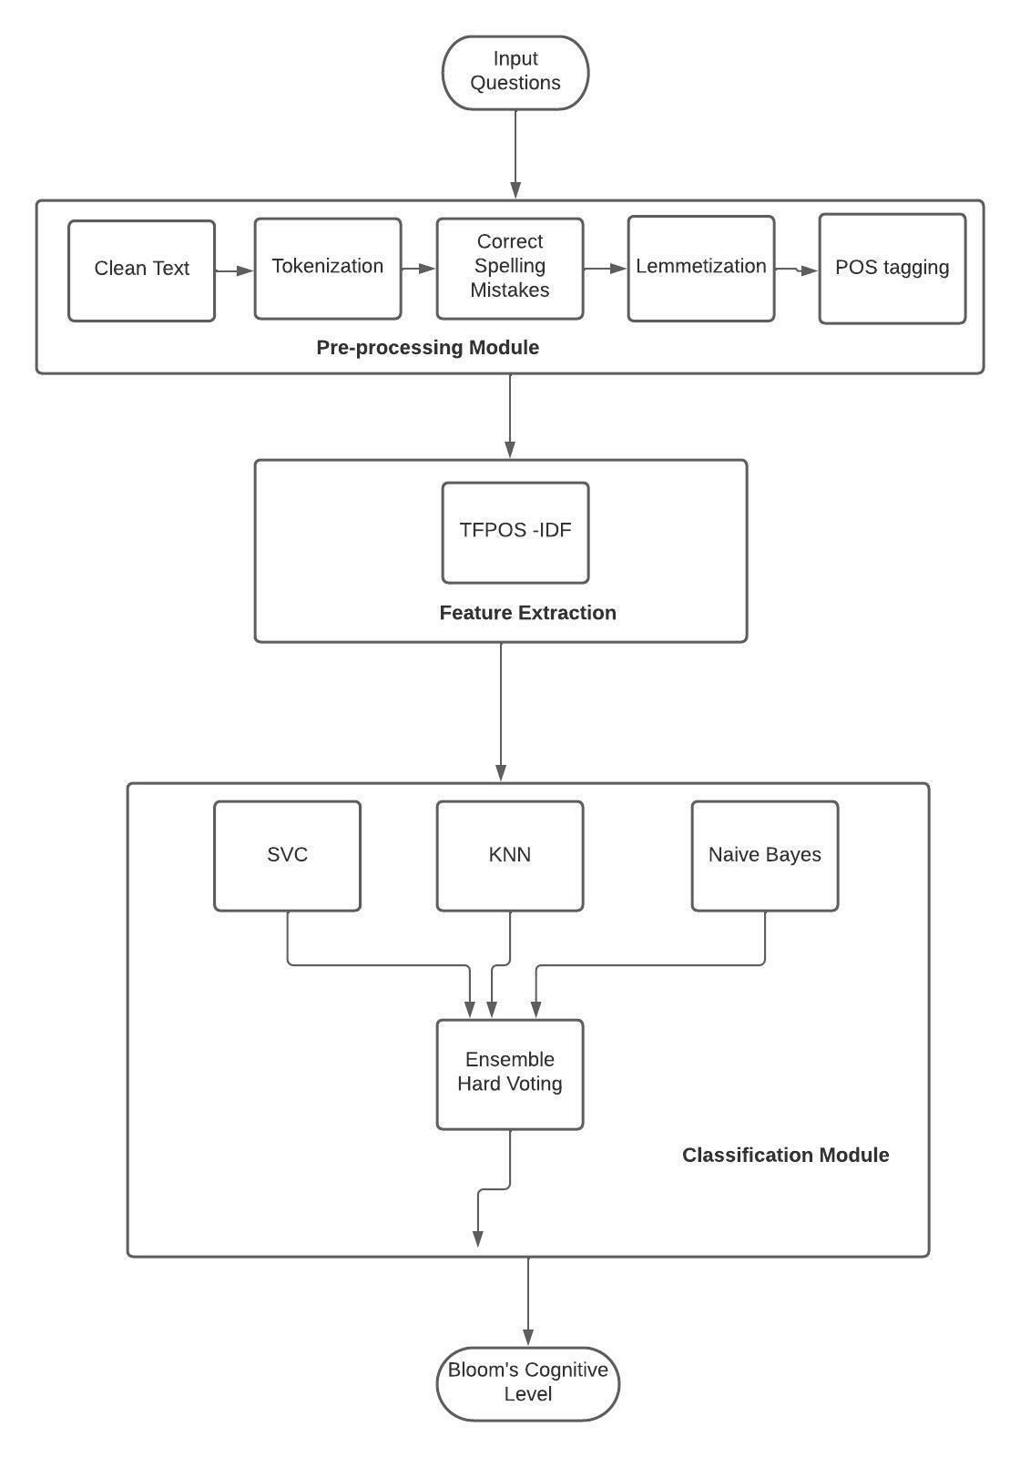
Proposed System - Classification Model
Notes:
The purpose of this model is to take a question paper as input and categorize each question into a Bloom’s Cognitive Level accurately. The structure of the model will be as follows:
NLP Preprocessing - Tokenization, Stop Words Removal, Lemmatization, POS Tagging
Feature Extraction - combination of TF-IDF.
Machine Learning Classification - SVM, KNN, Naive Bayes
Ensemble - applying majority voting algorithm on the output of the above classifiers.
Final output - combination of above output and WordNet similarity values which gives out the Bloom’s Cognitive Level for that question.

Slide 16
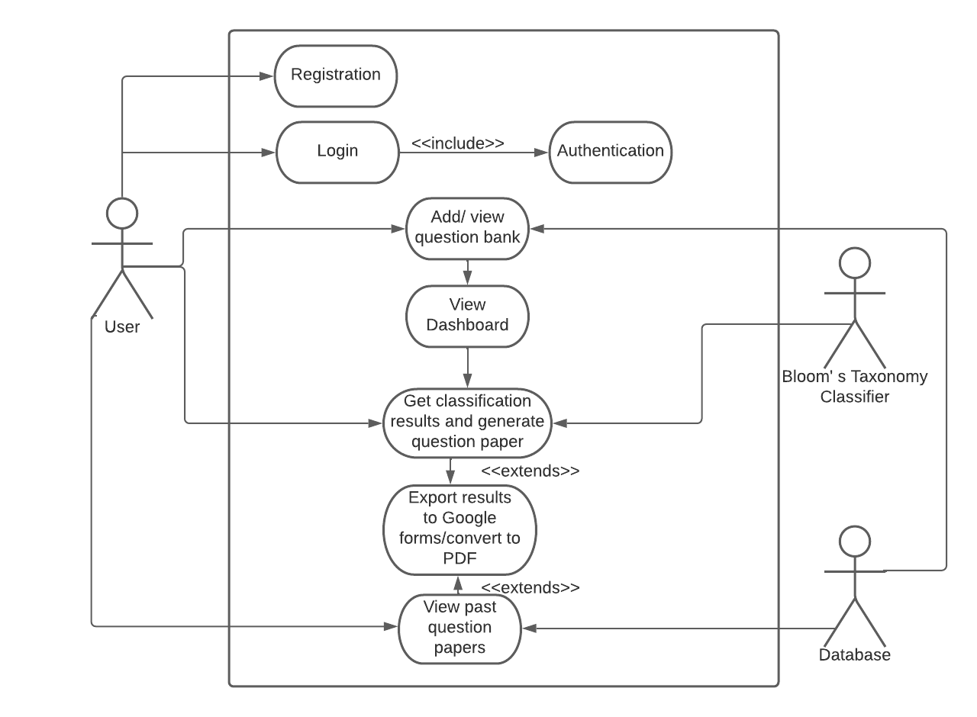
Proposed System- Use Case Diagram
System Interface
Notes:
user's possible interactions with a system
actors

Slide 17
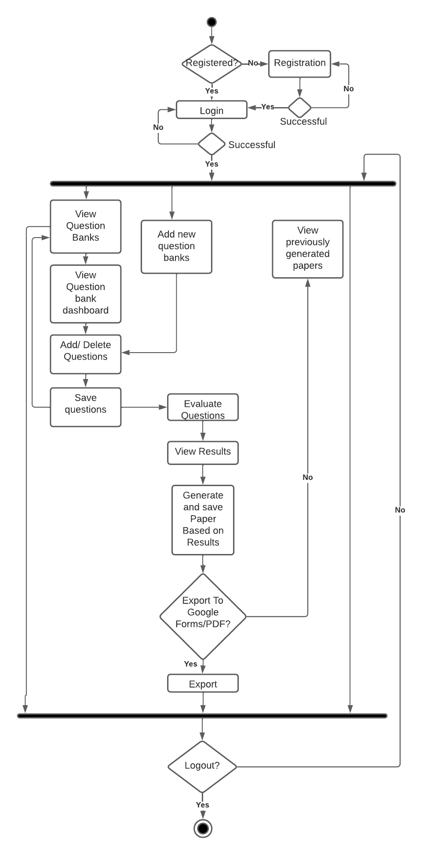
Proposed System-Activity Diagram
Notes:
flowchart that shows activities performed by a system.

Slide 18
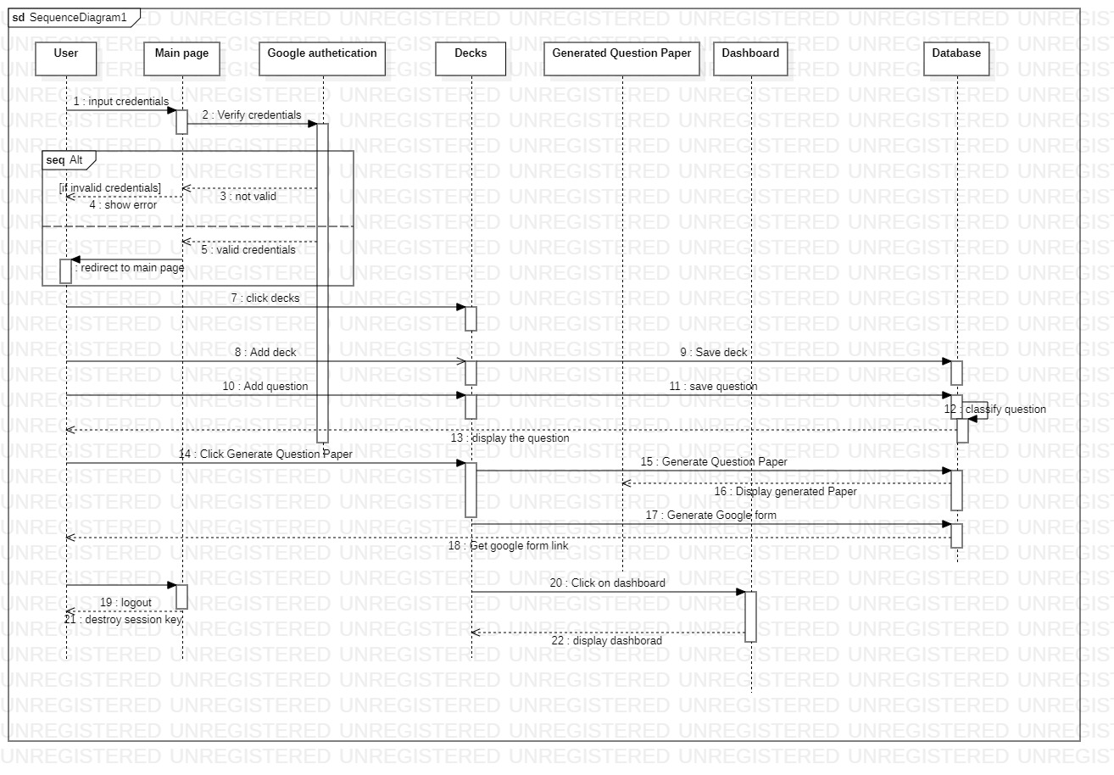
Proposed System- Sequence Diagram
Notes:
A sequence diagram simply depicts interaction between objects in a sequential order i.e. the order in which these interactions take place
User Actor others are lifelines:internal object of the system.

Slide 19
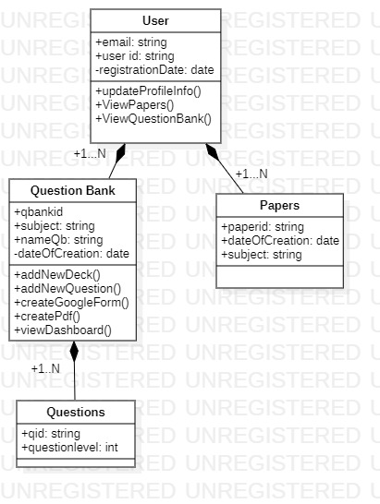
Proposed System- Class Diagram
Notes:
Class diagram: static view of an application
middle section constitutes the attributes,
Last section is the operations

Slide 20
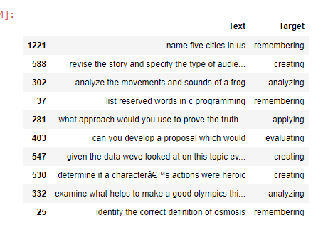
Snippet of the dataset
Notes:
Source of data: Research paper Question classification based on Bloom’s taxonomy cognitive domain using modified TF-IDF and word2vec[9]
2000 questions

Slide 21
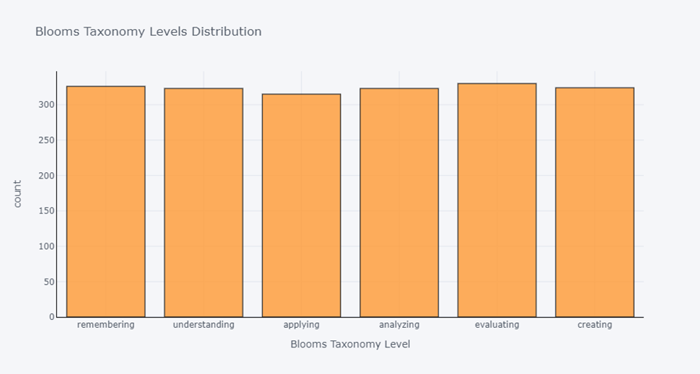
Distribution of levels in dataset
Notes:
Evenly distributed.good for model training.

Slide 22
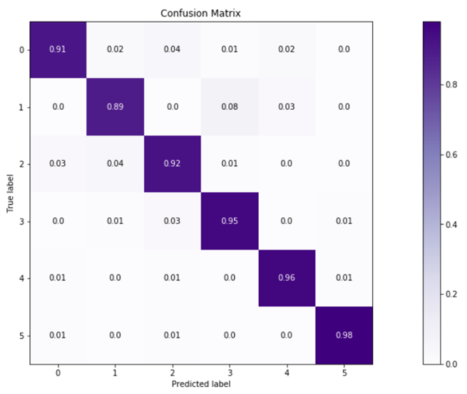
Confusion Matrix
Notes:
Read y axis vs x axis: x==y (true positives) diagonal values: i.e correctly predicted : super high

Slide 23
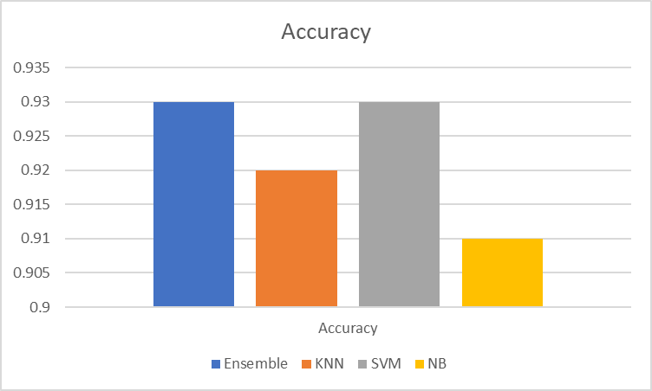
Notes:
Accuracy = Number of correct predictions/Total number of predictions

Slide 24
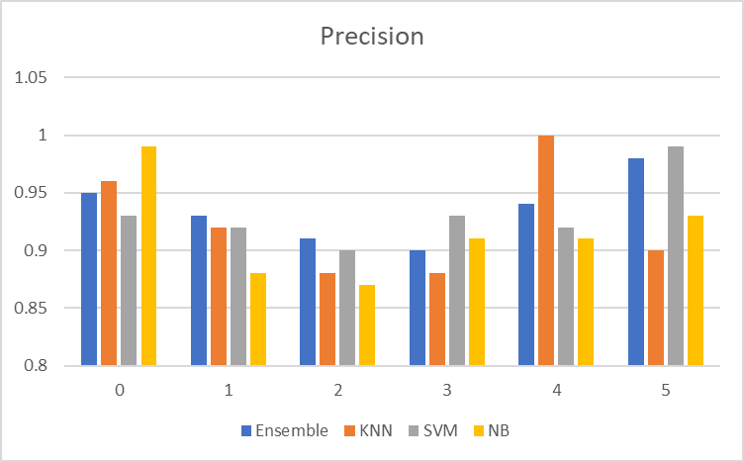
Notes:
Correctly predicted x / all predicted x
Out of all the predictions made as x, which ones were actually x?
Ensemble may not be having highest precision in all classes, but it is consistent and always above 90%.

Slide 25
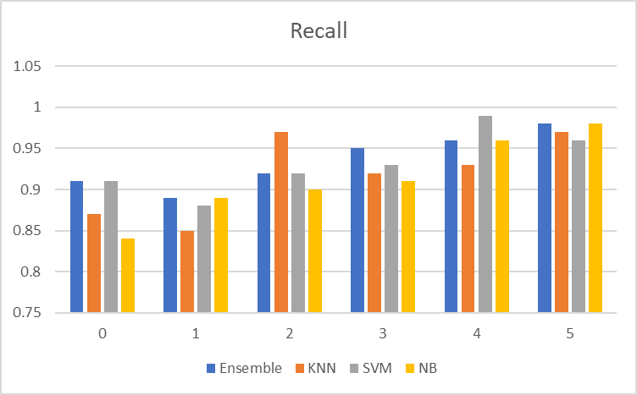
Notes:
Predicted x/ all actual x
Out of all the actual x, how many were predicted as x?
Ensemble may not be having highest recall in all classes, but it is consistent and overall better than other classifiers.

Slide 26
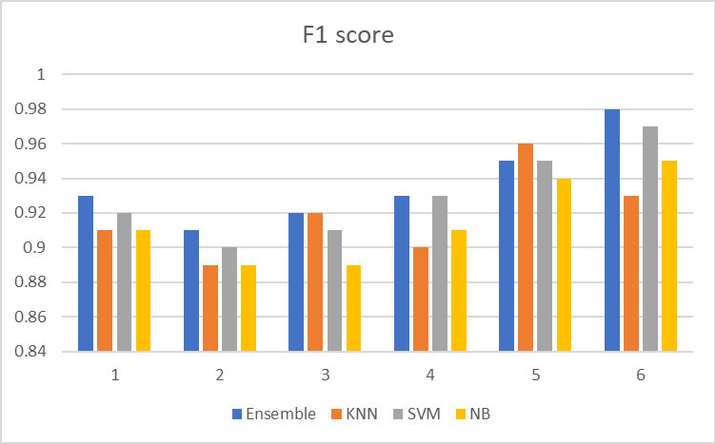
Notes:
The Precision-Recall Trade-Off represents the fact that in many cases, you can tweak a model to increase precision at a cost of a lower recall, or on the other hand increase recall at the cost of lower precision.F1 score is to combine the precision and recall metrics into a single metric.
high F1 score == both Precision and Recall are high
Ensemble is consistently highest in all categories except 5( where its second highest score) , thus we can conclude from f1 score n accuracy that the model is performing well.

Slide 27
Suggestions- sem 7 Project A seminar
Increase Bloom’s Taxonomy classification model accuracy (completed)
Make the presentation less verbose. (completed)
Add slide numbers to presentation. (completed)

Slide 28
Future Work
Create Google forms scripts to transport question papers directly to Google forms
Storing and viewing previously created question papers.
Generating a score to represent distribution in question bank.
Data collection for increasing performance.

Slide 29
Division of Work
Sr.No | Tasks | Team Members
1 | Requirements Gathering | All
2 | Planning | All
3 | OCR Module | Ojas and Aniket
4 | Question Bank Module | Neha and Vineeta
6 | Classification model | Neha and Vineeta
7 | Database design | Aniket and Ojas
8 | Backend Architecture | Aniket and Ojas

Slide 30
References
[1] H. S. G. A. a. N. V. P. Bhargav, "Application of bloom's taxonomy in day-to-day examinations.," in 6th International Conference on Advanced Computing (IACC), 2016.
[2] Y.-H. a. H.-W. C. Chang, "An automatic inference system for the quality analysis of test items based on the Bloom's revised taxonomy.," in 2009 International Conference on Machine Learning and Cybernetics. Vol. 5., 2009.
[3] P. a. K. N. Ranganathan, "A Bloom's Online Assessment Test (BOAT) to assess student learning outcome in a distance engineering education course.," in 2010 2nd International Conference on Computer Engineering and Technology. Vol. 6, 2010.
[4] K. M. B. a. I. P. Jayakodi, "An automatic classifier for exam questions in Engineering: A process for Bloom's taxonomy," in 2015 IEEE International Conference on Teaching, Assessment, and Learning for Engineering (TALE), 2015.
[5] B. a. J. C. Thomas, "The Effect of Bloom’s Taxonomy on Random Forest Classifier for cognitive level identification of E-content.," in 2020 International Conference on Emerging Trends in Information Technology and Engineering (ic-ETITE), 2020.
[6] W.-C. a. M.-S. C. Chang, "Automatic applying Bloom's taxonomy to classify and analysis the cognition level of English question items," in 2009 Joint Conferences on Pervasive Computing (JCPC), 2009.
[7] K. Makhlouf, "Exam Questions Classification Based on Bloom's Taxonomy: Approaches and Techniques," in 2020 2nd International Conference on Computer and Information Sciences (ICCIS), 2020.
[8] A. M. A. H. a. E. S. Aninditya, "Text Mining Approach Using TF-IDF and Naive Bayes for Classification of Exam Questions Based on Cognitive Level of Bloom's Taxonomy," in 2019 IEEE International Conference on Internet of Things and Intelligence System (IoTaIS), 2019.

Slide 31
References
[9] M. a. N. O. Mohammed, "Question classification based on Bloom’s taxonomy cognitive domain using modified TF-IDF and word2vec," in PloS one 15.3 (2020): e0230442, 2020.
[10] S. S. a. N. O. Haris, "A rule-based approach in Bloom's Taxonomy question classification through natural language processing," in 2012 7th international conference on computing and convergence technology (ICCCT), 2012.
[11] S. K. a. M. M. S. Patil, "A comparative study of question bank classification based on revised bloom’s taxonomy using svm and k-nn.," in 2017 2nd International Conference On Emerging Computation and Information Technologies (ICECIT)., 2017.
[12] E. R. a. I. L. Setyaningsih, "Categorization of Exam Questions based on Bloom Taxonomy using Naïve Bayes and Laplace Smoothing," in 2021 3rd East Indonesia Conference on Computer and Information Technology (EIConCIT)., 2021.
[13] G. A. a. S. H. D. Nidaa, "CLASSIFYING EXAM QUESTIONS BASED ON BLOOM'S TAXONOMY USING MACHINE LEARNING APPROACH," 2019.
[14] F. S. O. a. J. K. Nafa, "Automatic concepts classification based on bloom’s taxonomy using text analysis and the Naïve Bayes Classifier Method," in International Conference on Computer Supported Education. Vol. 3. SCITEPRESS, 2016.
[15] A. A. a. A. O. Yahya, "Automatic classification of questions into Bloom's cognitive levels using support vector machines," in The International Arab Conference on Information Technology, Naif Arab University for Security Science (NAUSS)., 2011.
.
Notes:
Question classification based on Bloom’s taxonomy cognitive domain using modified TF-IDF and word2vec

Slide 32
References
[16]K.A. Osadi a. Fernando a. W.V. Welgama, "Ensemble Classifier based approach for classification of exam questions into Blooms Taxonomy Cognitive Level" in The International Arab Conference on Information Technology, Naif Arab University for Security Science (NAUSS)., 2011
[17]T. T. Goh, "Questions Classification According to Bloom’s Taxonomy using Universal Dependency and WordNet," in Test engineering and management, 2020.

Slide 33
Implementation

Slide 34
Thank you!

